Slide 1
Introduction to the course
Notes:
1

Slide 2
Introduction to the course
Course introduction
Tutor’s introduction
About the course
Why you should take this course
Notes:
2

Slide 3
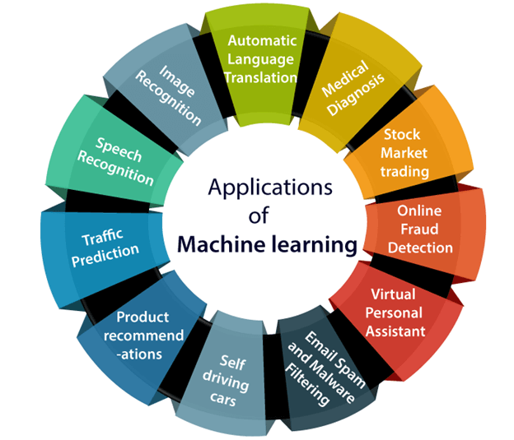
Introduction to the course
Course introduction
Notes:
3

Slide 4
Introduction to the course
Why DNN?
Notes:
4

Slide 5
Introduction to the course
Course importance
Curtains of machine learning will be lifted
Practical implementation of projects
Most widely used programming language(python)
Notes:
5

Slide 6
Introduction to the course
Overview of course
Introduction to python
Introduction to Machine Learning
Deep Neural Networks
COVID-19 Data analysis
Live implementation in TensorFlow
Optional part containing in-depth mathematics behind DNN
Notes:
6

